Slide 1
Mini Project 4
Samia, Sal, Nik

Slide 2
PART I: SINGLE-TABLE QUERIES

Slide 3
Query 1, 2 and 3
#1. Get a list of all film titles alphabetized by title.
select title from film order by title;
#2. Find the description, release year, length, and rang for the movie “KENTUCKIAN GIANT”.
select title, release_year, length, rating from film where title = 'KENTUCKIAN GIANT';
#3. Find the first name and last name of each employee (staff table). Your query should include the last name first, and then the first name.
select first_name, last_name from staff;

Slide 4
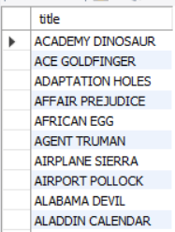


Query 1, 2 and 3 Results

Slide 5
Query 4, 5, and 6
#4. Repeat the query above, but this me, the results should include only one column with the format last name, first name. The output column should be named “name”
select concat(last_name, ' ', first_name) as name from staff;
#5. Get the number of customers. The output should be a single number. Name the column “num_customers”
select count(customer_id) as num_customers from customer;
#6. Get the number of customers who are active vs inactivesys in the system.
select active, count(active) from customer group by active;

Slide 6



Query 4, 5 and 6 Results

Slide 7
Query 7 and 8
#7. Get the average amount a customer spends on a rental.
select avg(amount) from payment;
#8. Get maximum amount any customer has spent on a rental.
select max(amount) from payment;

Slide 8


Query 7 and 8 Results

Slide 9
Query 9 and 10
#9. Get a list of the actors. The results should include only one column with the format last name, first name. The column should be named “actor_name” The results should be sorted be sorted alphabetically by the last name (ascending).
select concat(last_name, ' ', first_name) as actor_name from actor order by last_name asc;
#10. Repeat this query above, but the results should be in reverse order.
select concat(last_name, ' ', first_name) as actor_name from actor order by last_name desc;

Slide 10
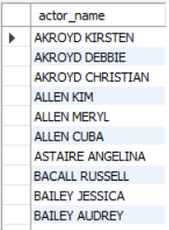
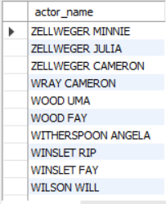
Query 9 and 10 Results

Slide 11
PART I: MULTI-TABLE QUERIES

Slide 12
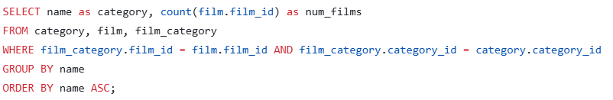
Query 1: Get a list of category names and a count of movies that fall into that category. Name the category column “category” the count column “num_films”. Order the results alphabetically (ascending). Use the WHERE clause to join the tables.
Query 2: Repeat the query above using a JOIN clause instead of the WHERE clause.
Query 1 (Using WHERE) and Query 2 (Using JOIN)

Slide 13
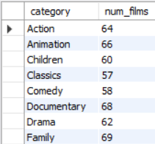
Results from Query 1 and Query 2

Slide 14
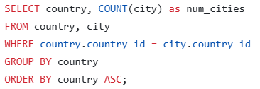

Query 3: Get a list of country names and a count of the cities that are in that country. Name the count column “num_cities”. Order the results alphabetically (ascending). Use the WHERE clause to join the tables.
Query 4: Repeat the query above using a JOIN clause instead of the WHERE clause.
Query 3 (Using WHERE) and Query 4 (Using JOIN)

Slide 15
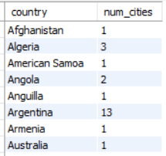
Results from Query 3 and Query 4

Slide 16
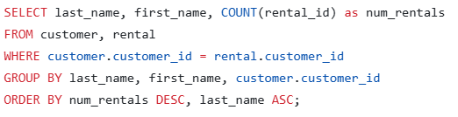

Query 5: Get a list of each customer’s last name and first name and the number of rentals they have. Name the count column “num_rentals”. Order the result by the number of rentals in descending order. The highest number of rentals should be at the top. Sort any ties (same number of rentals) by last name (ascending). Use the WHERE clause to join the tables..
Query 6: Repeat the query above using a JOIN clause instead of the WHERE clause.
Query 5 (Using WHERE) and Query 6 (Using JOIN)

Slide 17
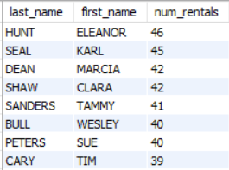
Results from Query 5 and Query 6

Slide 18
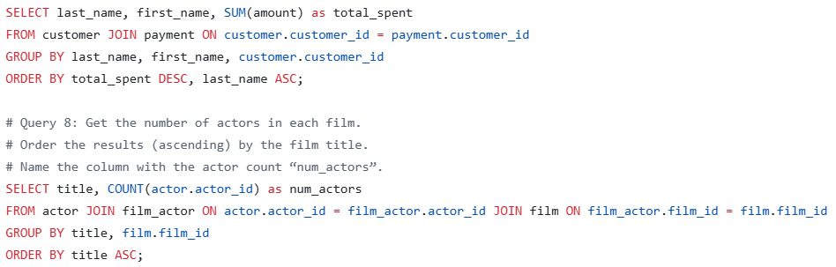
Query 7: Get a list of each customer’s last name and first name and the amount of money they have spent on rentals. Name the sum column “total_spent”. Order the result by the amount in descending order. The highest amount of money spent should be at the top. Sort any ties (amount of money spent) by last name (ascending). Use the JOIN clause for this query.
Query 8: Get the number of actors in each film. Order the results (ascending) by the film title and name the column with the actor count “num_actors”..
Query 7 and Query 8

Slide 19
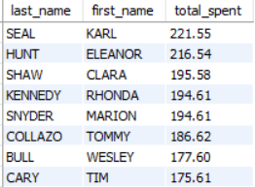
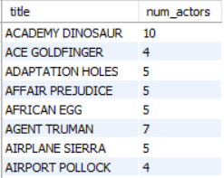
Results from Query 7 and Query 8
Query 7:
Query 8:

Slide 20
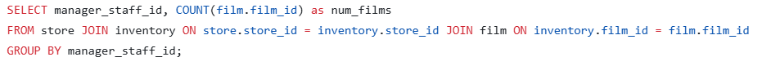
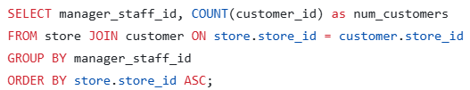
Query 9: Get the number of films each manager holds. Use only the manager staff id to identify the manager. Name the column with the number of films “num_films”.
Query 10: Get the number of customers per manager. Use only the manager staff id to identify the manager. Name the column with the number of films “num_customers”. Order by store id (ascending).
Query 9 and Query 10

Slide 21


Results from Query 9 and Query 10
Query 9:
Query 10:

Slide 22
PART II: DATA VISUALIZATION

Slide 23
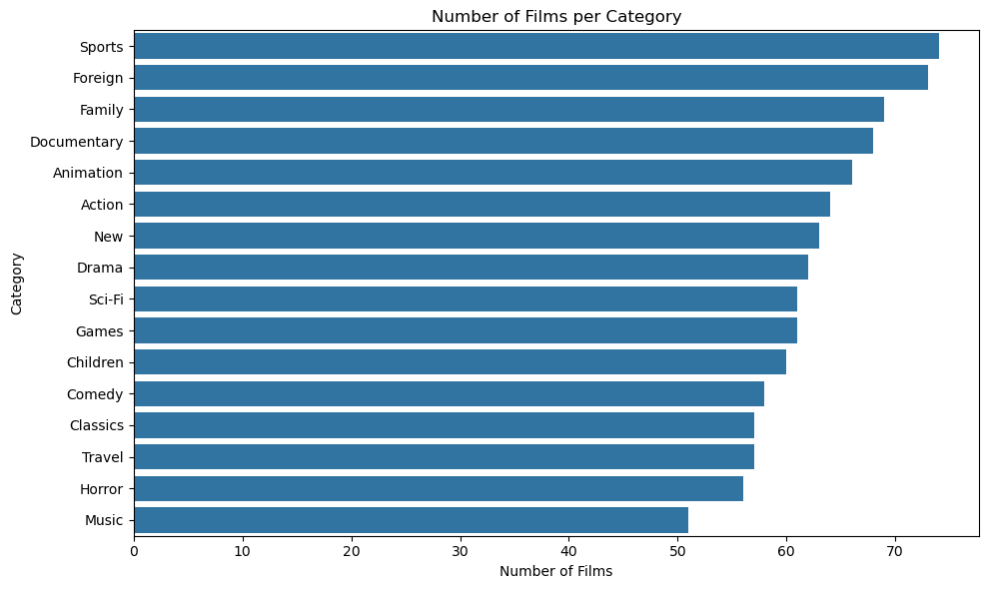

Slide 24
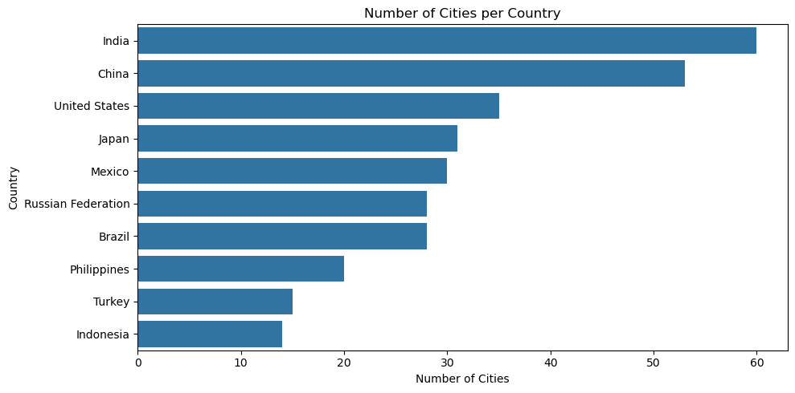

Slide 25
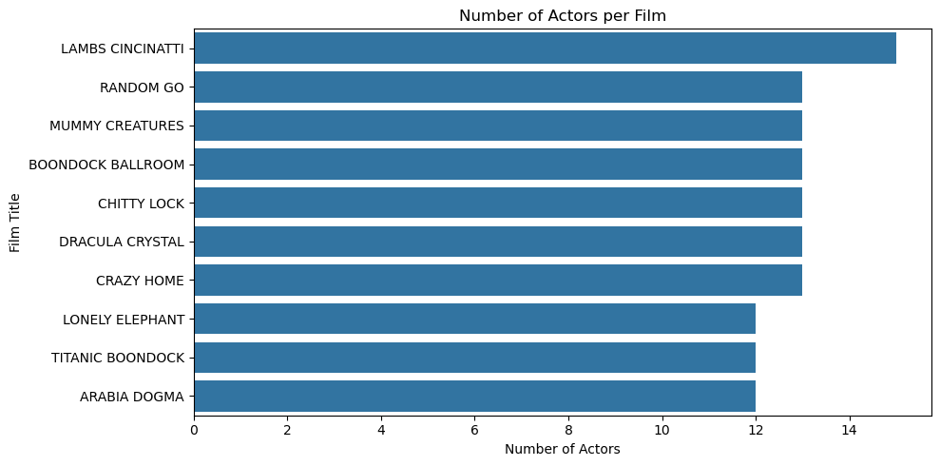

Slide 26
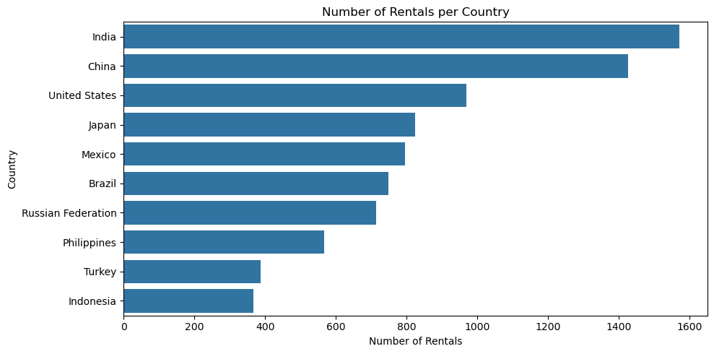

Slide 27
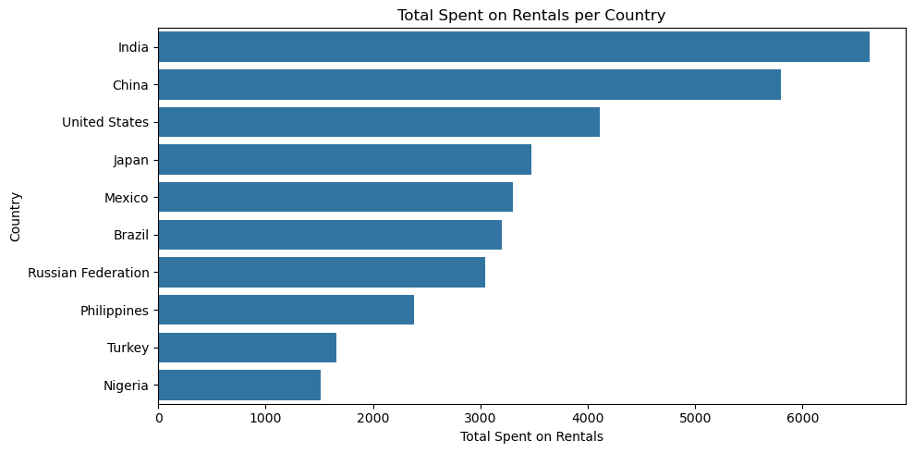

Slide 28
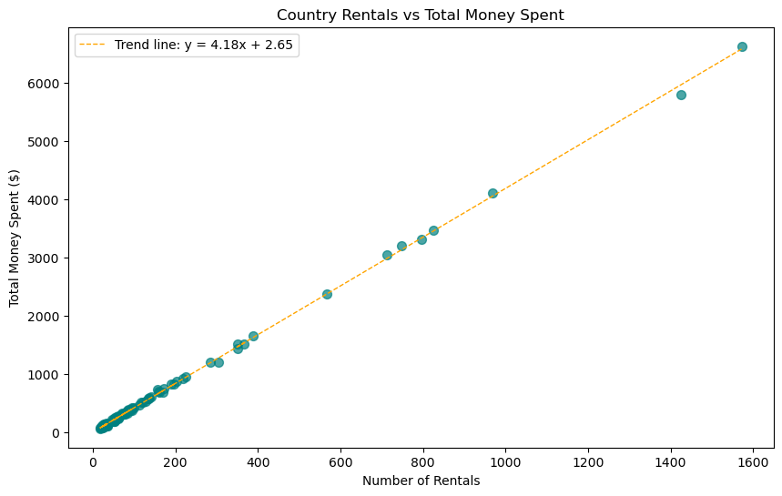

Slide 29
PART II: MODELING

Slide 30

Simple Linear Regression
108 rows
Dependent Variable: 'total_spent'
Independent: 'num_rentals'

Slide 31
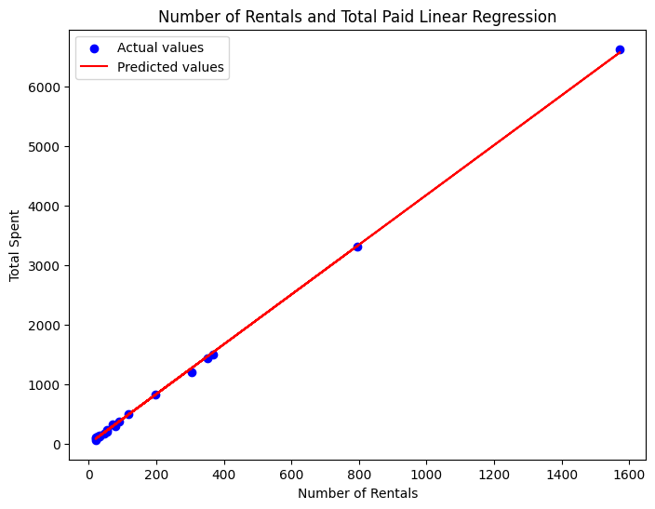

Slide 32
THANK YOU

